Slide 1
Scientific Foundations of Health
Unit-1

Slide 2
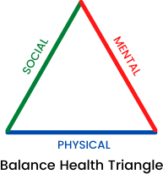
What Is health? In 1948, the World Health Organization (WHO) constitution states : “Health is a state of complete physical, mental and social well-being and not merely the absence of disease and infirmity”.
Health- its importance, factors
2

Slide 3
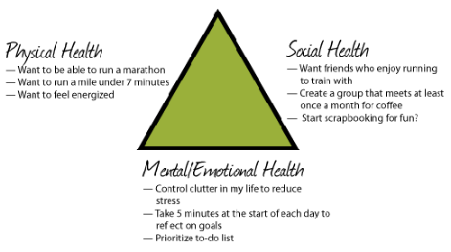

Slide 4
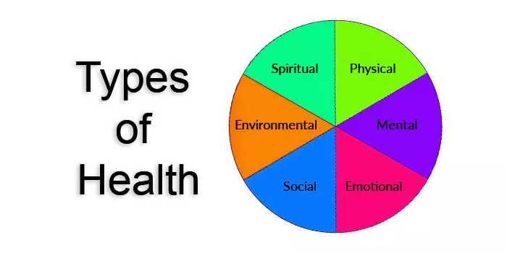

Slide 5
A. Physical
Physical health is the state of being free from illness and injury.
1. Fitness:
Exercise regularly
Maintain weight
Stay active
Rest

Slide 6
A. Physical
Physical health is the state of being free from illness and injury.
2. Nutrition: The process of providing or obtaining the food necessary for health and growth
Balanced diet
Carbohydrates
Proteins
Fats
Vitamins
Minerals

Slide 7
A. Physical
Physical health is the state of being free from illness and injury.
2. Nutrition: The process of providing or obtaining the food necessary for health and growth
Balanced diet
Carbohydrates
Proteins
Fats
Vitamins
Minerals

Slide 8
A. Physical
Physical health is the state of being free from illness and injury.
3.Medical self care: WHO defines self care as “the ability of individuals, families and communities to promote health, prevent diseases, maintain health and to cope with illness and disability with or without the support of health care provider.
Routine health check ups
Proper vaccination

Slide 9
A. Physical
Physical health is the state of being free from illness and injury.
4. Control of substance abuse:
Avoid smoking , alcohol and drugs
Avoid addiction

Slide 10
B.Mental
Mental health is a state of well-being in which an individual realizes his or her own abilities, can cope with the normal stresses of life, can work productively and is able to make a contribution to his or her community
1. Emotional:
Identifying and nurturing feelings and conscious inner state
Journaling
Practice gratitude & positive mindset
Meditation

Slide 11
B.Mental
Mental health is a state of well-being in which an individual realizes his or her own abilities, can cope with the normal stresses of life, can work productively and is able to make a contribution to his or her community
2. Psychological:
Guided meditation
Deep breathing
Manage social media time
Connect with others
Stress management

Slide 12
C.Social
Social well being is sense of belonging to community and making contribution to society
Being connected with friends, family and community
Giving and receiving support
Having meaningful relationships
Being active member of society
Caring for and about others

Slide 13
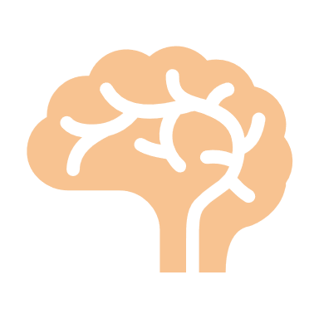


Emotion: Subjective state of Mind, Reaction to Internal or external stimuli Stimuli.
Intellect : A person’s Mental abilities. reasoning and understanding objectively. Psychological: Arising in mind. Related to mental and emotional State of a person. Physiological : Related to body, its parts and working
Spiritual : Related to Soul or Human Spirit. No material or physical things.

Slide 14
Why is health important?
Health is the body's functional and metabolic efficiency, and its ability to adapt to the physical, mental, and social changes that it is exposed to.
A healthy person is a person who is able to serve himself, his nation and his community.
Presence of healthy individuals in society, means the presence of productive individuals who possess the power and the ability to give and serve.
Psychologically healthy people feel comfortable and happy in their lives. They enjoy life well, establishing his relationships with people and showing love and kindness.
A healthy person who is far from the disease sees him saving money that he would have spent on the disease if he neglected his health

Slide 15
Why Is Health Important Now?
Social distancing and the loss of routine can create pressure both physically and psychologically. Parallelly, all are enforced to perform at the same level.
Many people are struggling to work full-time remotely while simultaneously caring for their family at home.
Health workers are overloaded.
Take time to listen to body and mind (physically, mentally, emotionally).
Positive self talk, meditation, Yoga.

Slide 16
Why Is Health Important Now?
Nutrition : Healthy food
Physically active: Move your body
Rest: Prioritize sleep
Socialize virtually: Find ways to connect socially
Find ways to ease stress
https://www.who.int/emergencies/diseases/novel-coronavirus-2019

Slide 17
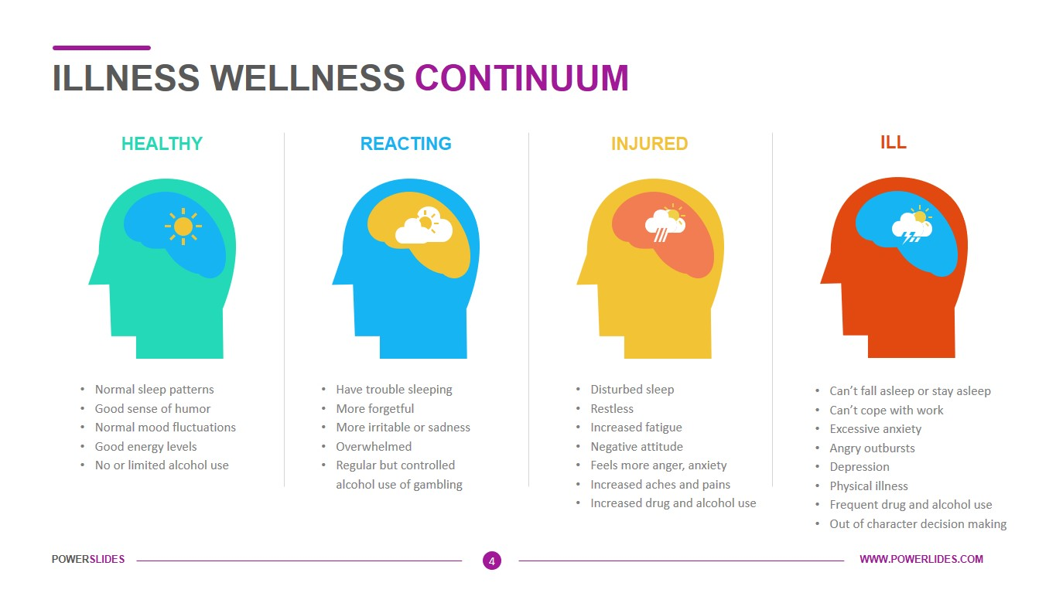
Why is health important now?
8

Slide 18
What influences Health?
Social and economic environment
Physical environment
Person’s individual characteristics and behaviors.
Income and social status
Education
Employment and working conditions
Social support networks
Culture.
Genetics
Personal behavior and coping skills
Health services - access
Gender
https://www.who.int/news-room/questions-and-answers/item/determinants-of-health

Slide 19
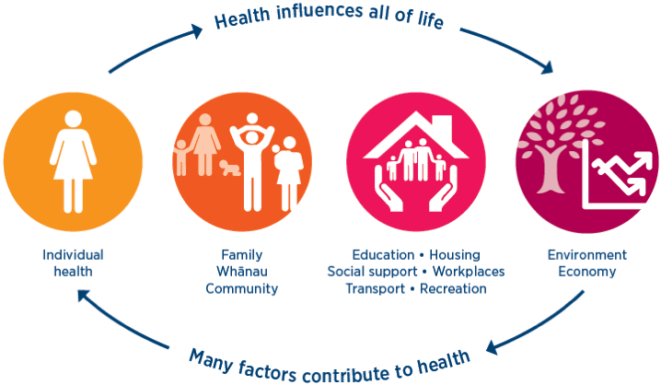
What influences Health?
https://www.who.int/news-room/questions-and-answers/item/determinants-of-health

Slide 20
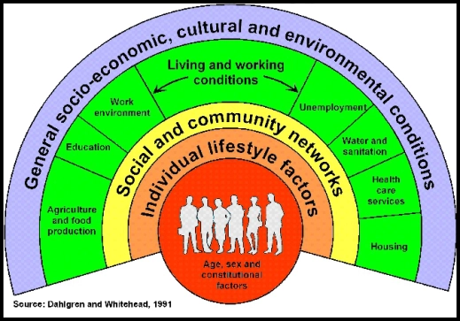
What influences Health?

Slide 21
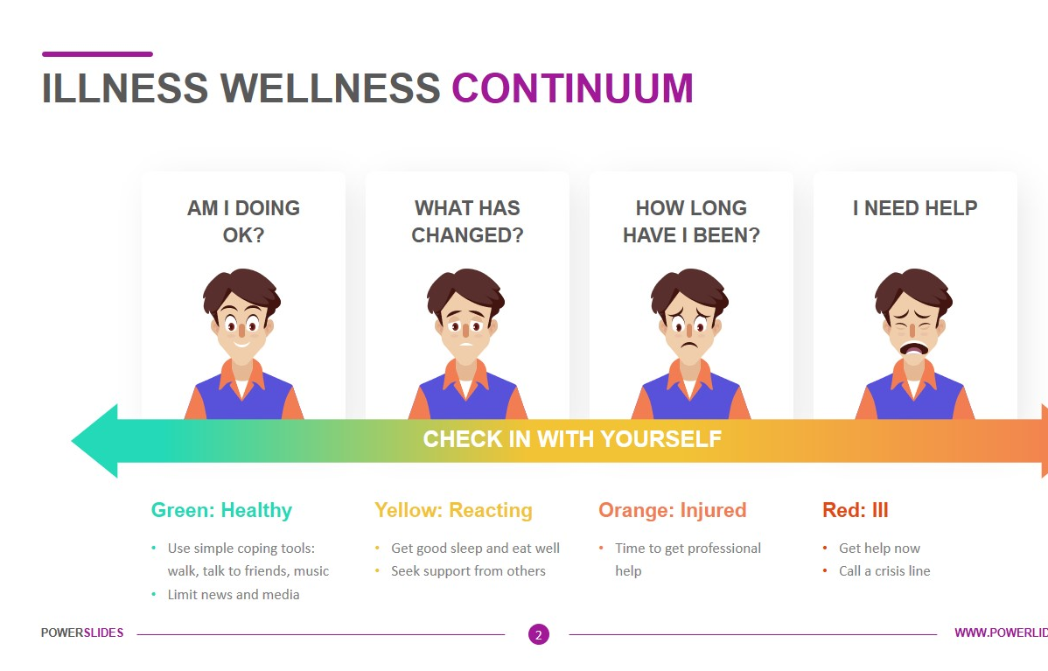

Slide 22
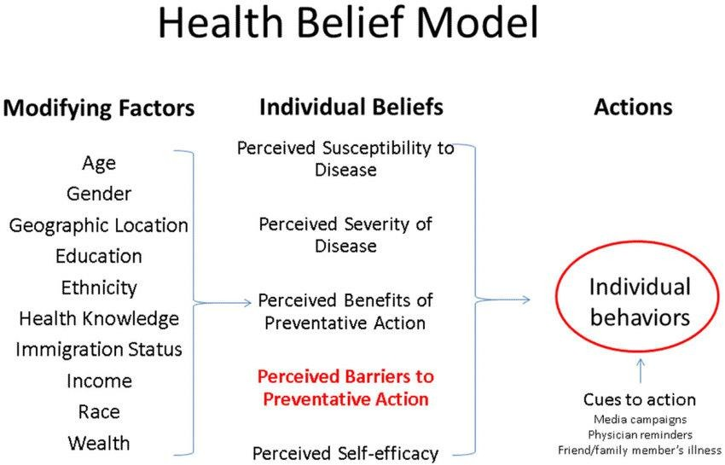
Health Beliefs
Health beliefs are what people believe about their health, what they think constitutes their health, what they consider the cause of their illness, and ways to overcome an illness it.
Health beliefs are culturally determined, and all come together to form larger health
belief systems.

Slide 23
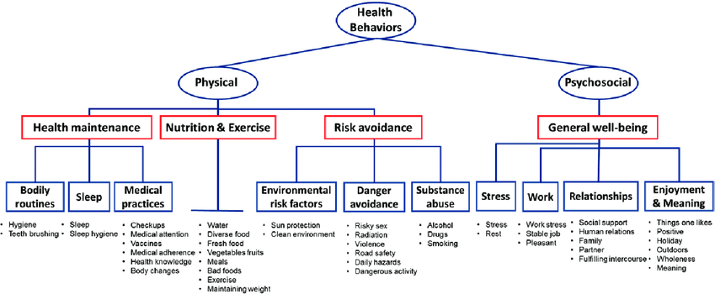
HEALTH AND BEHAVIOR
Health behaviors are actions individuals take that affect their health.
Behavioral factors such as physical activity and diet, tobacco use, alcohol abuse, disease screening etc. exert strong influence on health

Slide 24
Health and Advertisements
A notice or announcement in a public medium promoting a product, service, or event or publicizing a job vacancy is called Advertisement.
Advertising means: newspaper, TV, radio, magazine, internet, etc.
Health related advertisement are for Fitness, Medical, Wellness, Pharmaceutical & Health brands. Advertisements extensively discuss food and nutrition, tobacco, alcohol, and prescription drugs.
Research indicates that these health-related communications can have significant and measurable effects on consumer cognitions, emotions, and behaviors. 48% of people exposed to the health-promoting advertisements made searches within the next month for weight loss information.
Food products, Health supplements, Gyms, group workouts, anti-aging products,
Health instruments, Health insurance, beauty products
Advertisement has both positive and negative influence on health

Slide 25
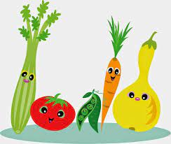
Good Health Benefits
Short Term Benefits
Maintain weight
Feel better i.e. Good energy and mood
Improved mental clarity
Supports daily activities and help recovery
More resilient to pressure and stress
Better Stress Management
Avoid Addictions
Protect Eyesight
Lower Medical Costs
High Self-Esteem
13

Slide 26
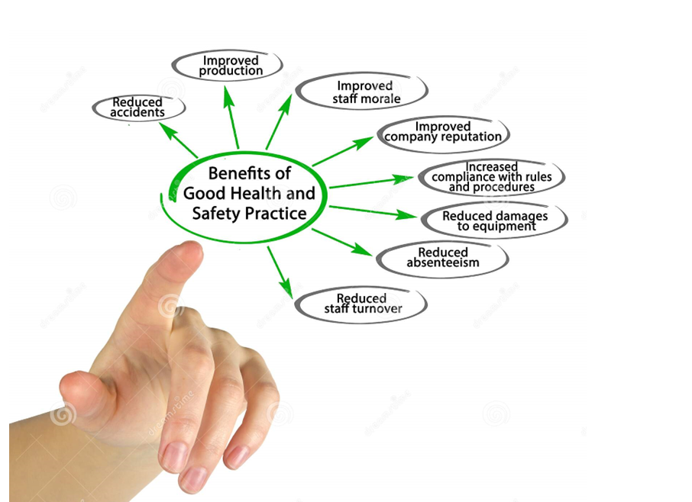
Good Health Benefits
13

Slide 27
Good Health Benefits
Long Term Good Health Benefits
Live happy life
Longer life span.
More energy to purse dreams.
Maintains weight and physical appearance
Increased Immunity
Great sense of well being: Enhanced self- esteem
Improves overall quality of life.
Role model to others
Good health has positive influence.
13

Slide 28
Health and Society
Society is an organization or club formed for a particular purpose or activity.
An individual’s social environment can positively or negatively affect a person’s health
Social environment factors: A social environment has to do with the culture and relationships that surround an individual.
Occupation and income status
Education
Family and friends
Access to health care
Social Environment and Weight Gain
Social Environment and mental health
Social Environment and Disease Onset

Slide 29
Health And Family
“Family is a group of biologically- related persons living together and sharing the
common kitchen and purse”.
The health of one member affects the welfare of other members in the family.
Every family is unique and it is affected by ever aspect of community life.
Family health is “a state of positive interaction between family members which enables each members of the family to enjoy optimum physical, mental, social and spiritual well-being”.

Slide 30
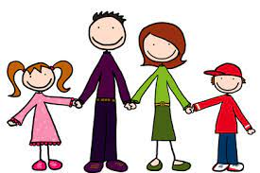
Health And Family
Functions of family:
Socialization of family members.
Economic stability.
Care of dependent members.
Emotional support for members.
Satisfy social, intellectual, emotional and psychological needs of family
Upbringing children for behavior and social approved conduct.
Sense of family identification
Interaction among family members in health, disease, counselling and rehabilitation

Slide 31
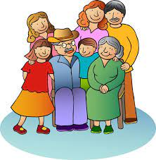
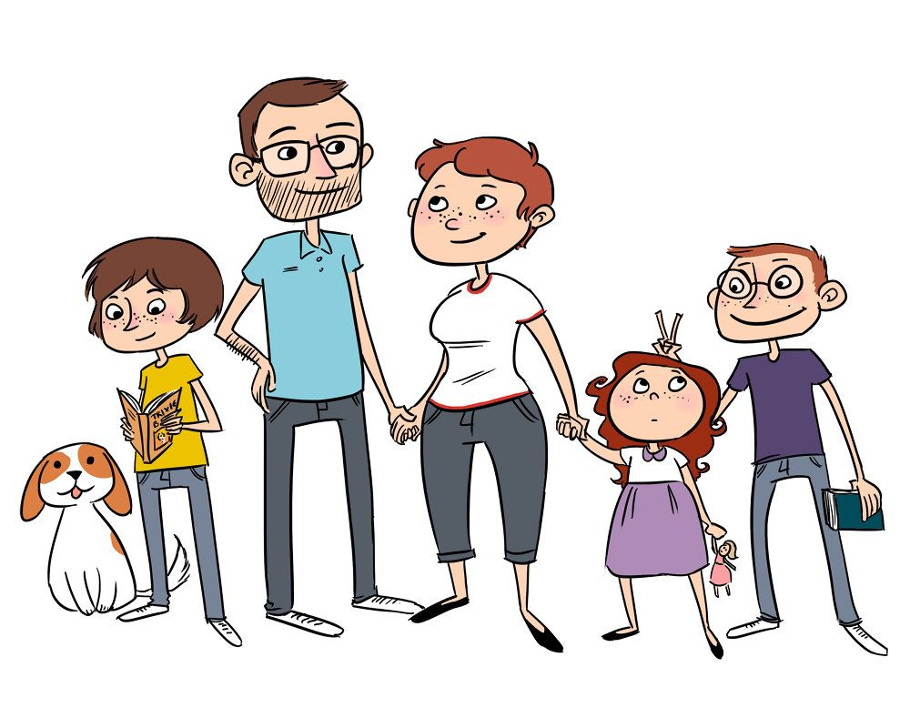
Health And Family
Determinants of family health
Living and working conditions
Physical environment
Psycho-social environment
Education and economic factors
Health practices
Cultural factors
Gender
Genes

Slide 32
Health and Personality
Personality traits are generally defined as a person’s characteristic thoughts, feelings, and behaviors.
Introverts(people who are typically quiet, reserved, and introspective) and extroverts (people who are social and outgoing)
Optimistic (People who are positive and assume good things last) and pessimistic (people who have negative feelings).
Neurotic (people who experience anxiety, depression, shy, self-doubt)
Conscientious (people who are high-achieving, dependable, careful)
Resilient (people adapting well to adversity, trauma, tragedy or stress)
Narcissistic (self-centered people)
Personality traits may influence whether a person engages in health-enhancing or health-damaging behaviors.

Slide 33
Health and Profession
Work-related problems can affect our physical, emotional and mental health.
Common causes of work-related stress are :
Job dissatisfaction
Workplace injury
Stress
Discrimination, bullying, violence
Retirement
Long hours
Heavy workload
Poor pay
Boredom
Safety issues
No promotions
Job insecurity
Conflicts with co-workers or bosses.
Unemployment

Slide 34
Health and Profession
The stress of dealing with changing work circumstances that are out of your control can increase the risk of health problems such as anxiety and depression
Disparities of health in different vulnerable groups
Health disparity is “a particular type of health difference that is closely linked with social, economic, and/or environmental disadvantage” . Certain groups in the society often encounter discriminatory treatment and need special attention to avoid potential exploitation are called vulnerable Groups
Race and ethnicity: caste classifications
Gender.
Sexual identity and orientation.
Disability status or special health care needs.
Geographic location (rural, urban and migrants)

Slide 35
Link for YouTube videos/ Animation videos:
https://www.youtube.com/watch?v=71_NkXgAK1g
https://www.youtube.com/watch?v=mwuahwbIBnE

